Slide 1
Database Management System
Mini Project
21CSC205P -Database Management Systems
Presented By
RA2211032010028 – Asmitha
RA2211032010040– Maneesh
RA2211032010041 – Hemanth
Guide
Dr.S.Thanga Revathi
Assistant Professor
Dept of CTech

Slide 2
Problem understanding
An expense tracker in a database management system (DBMS) involves designing a system where users can record and manage their expenses efficiently. The goal is to create a database schema that includes tables for users, expenses, and categories. Users should be able to log in, add new expenses, categorize them (e.g., food, transportation, utilities), and generate reports based on different criteria like monthly expenses or category-wise spending. The system should also prioritize security, ensuring that users can only access their own data. Overall, the challenge lies in implementing a user-friendly interface, robust database structure, and efficient querying mechanisms to support a seamless expense tracking experience.

Slide 3
Identification of Entity and Relationships
Entities:
User: The User entity represents individuals who use the expense tracker system. Each user has a unique identifier (user_id) and provides essential information like username, password (hashed for security), and email.
Description: The Expense entity represents individual expense transactions recorded by users. Each expense record is associated with a specific user (user_id), a category (category_id), an amount, date, and optional description. The expense_id uniquely identifies each expense entry.
Category: The Category entity defines different types or categories to which expenses can be assigned. Each category has a unique identifier (category_id) and a name that describes the type of expense (e.g., Food, Transportation).

Slide 4
Relationships:
User-Expense Relationship: Each User can have multiple Expense records. - One-to-Many relationship (1 User -> Many Expenses).
Expense-Category Relationship: Each Expense belongs to one specific Category. - Many-to-One relationship (Many Expenses -> 1 Category).

Slide 5
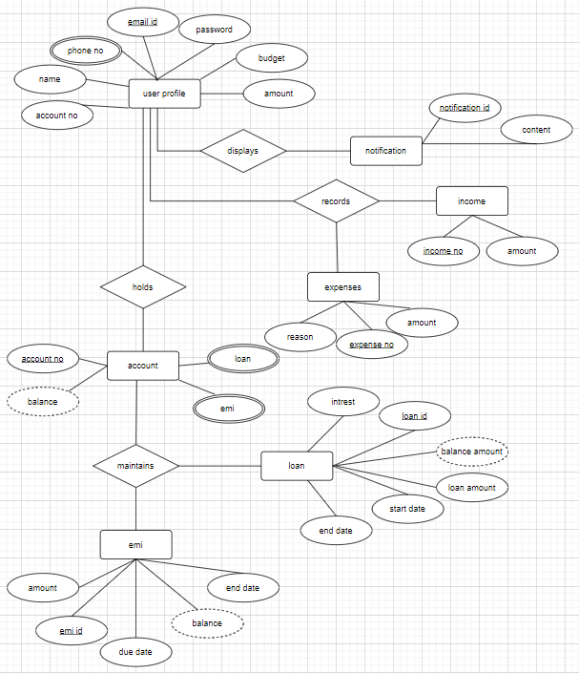
Construction of DB using ER Model for the project

Slide 6
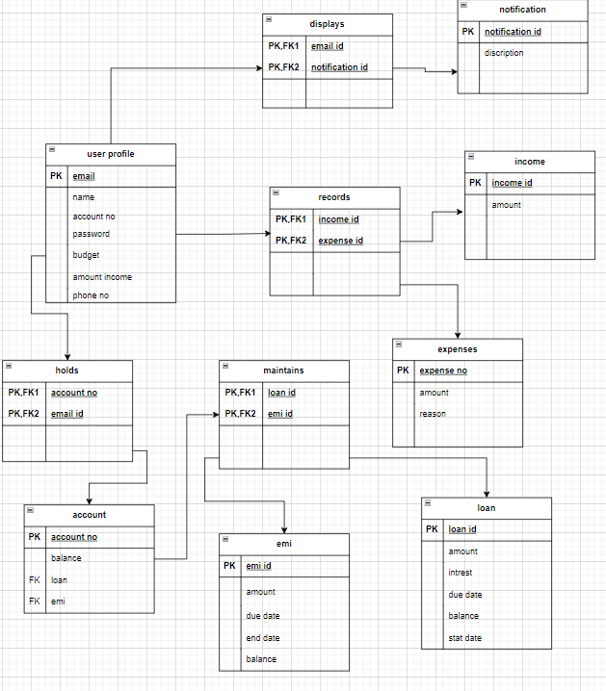
Design of Relational Schemas

Slide 7
Joins
To Retrieve all distint transactions
SELECT DISTINCT T_Type
FROM Transaction;
to RETRIVE USER PROFILE ALONG WITH ACCOUNT TYPE
SELECT U.U_Name, AT.A_Type
FROM User_Profile U
INNER JOIN Account A ON U.U_ID = A.U_ID
INNER JOIN Account_Type AT ON
A.Type_ID = AT.Type_ID;

Slide 8
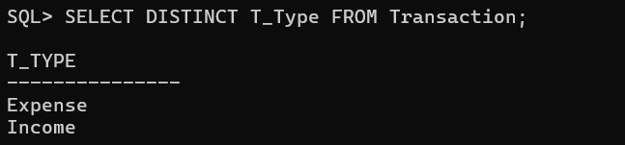
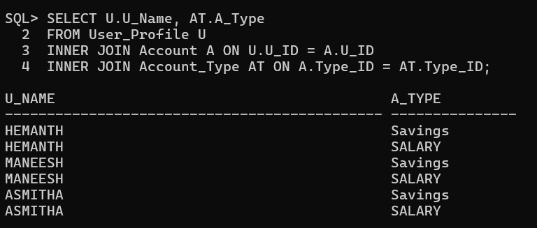

Slide 9
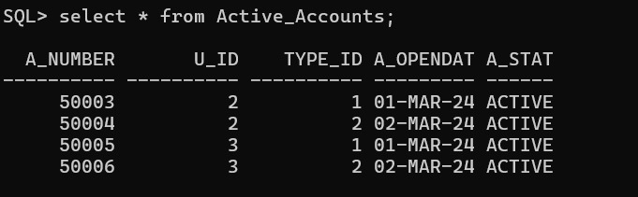
Views
Create a view to display all active accounts:
CREATE VIEW Active_Accounts AS
SELECT * FROM Account WHERE A_Status = 'ACTIVE';

Slide 10
Triggers
Update Account Balance using Triggers:
CREATE OR REPLACE TRIGGER
update_balance
AFTER INSERT ON Transaction
FOR EACH ROW
BEGIN
IF :NEW.T_Type = 'Income' THEN
UPDATE Account
SET A_BALANCE = A_BALANCE
+ :NEW.T_Amount
WHERE A_Number = :NEW.A_Number;
ELSIF :NEW.T_Type = 'Expense' THEN
UPDATE Account SET A_BALANCE = A_BALANCE
- :NEW.T_Amount
WHERE A_Number = :NEW.A_Number;
-- Handle other transaction types as needed END IF; END;

Slide 11
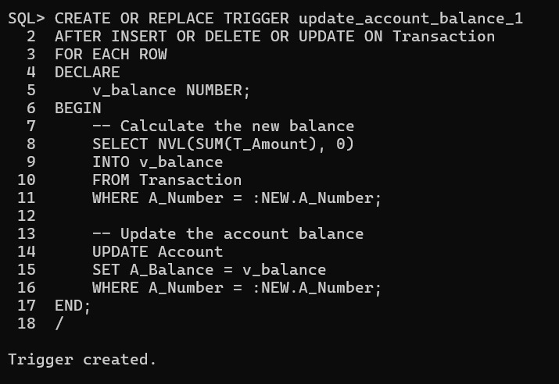

Slide 12
Cursors
CREATE OR REPLACE PROCEDURE calculate_total_expenses (account_id IN NUMBER)
IS
total_expense NUMBER;
CURSOR expense_cursor IS
SELECT T_Amount
FROM Transaction
WHERE A_Number = account_id
AND T_Type = 'Expense’;
BEGIN
total_expense := 0;
FOR expense_rec IN expense_cursor
LOOP
total_expense := total_expense + expense_rec.T_Amount;
END LOOP;

Slide 13
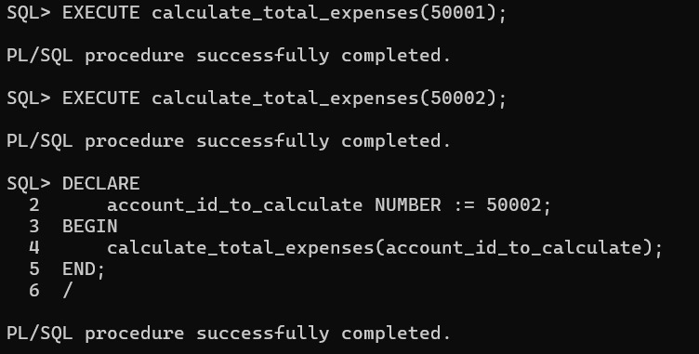
DBMS_OUTPUT.PUT_LINE('Total Expenses for Account ' || account_id || ': ' || total_expense);
END;/

Slide 14
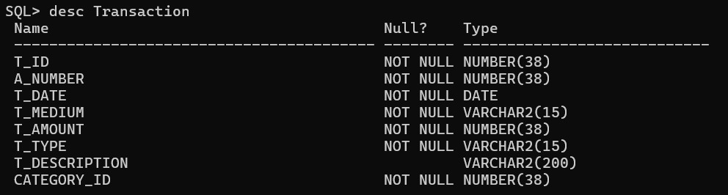
Normalisation
Original Table

Slide 15
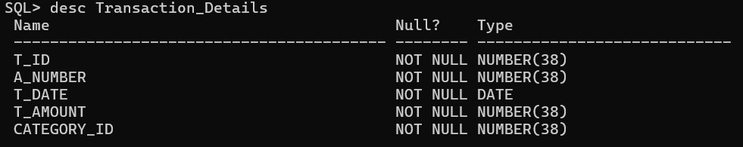
Normalised Table:

Slide 16
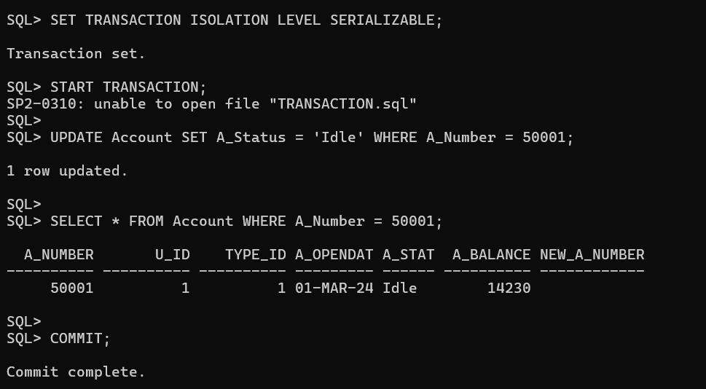
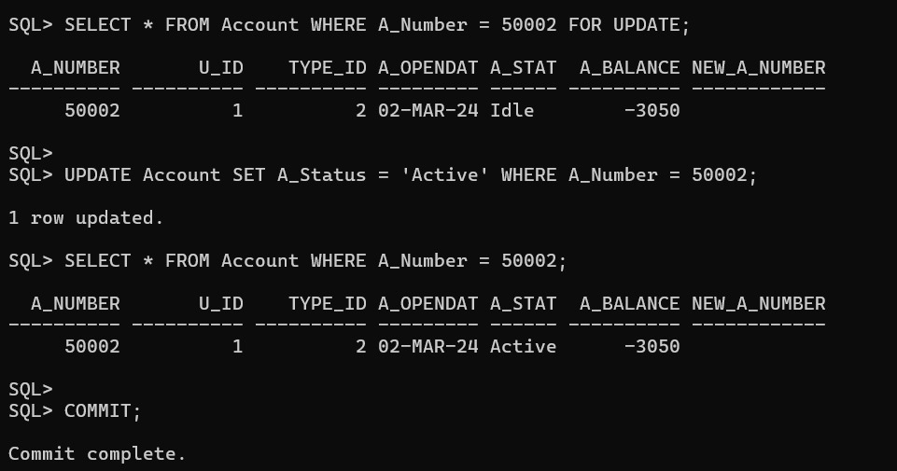
Concurrency Control

Slide 17
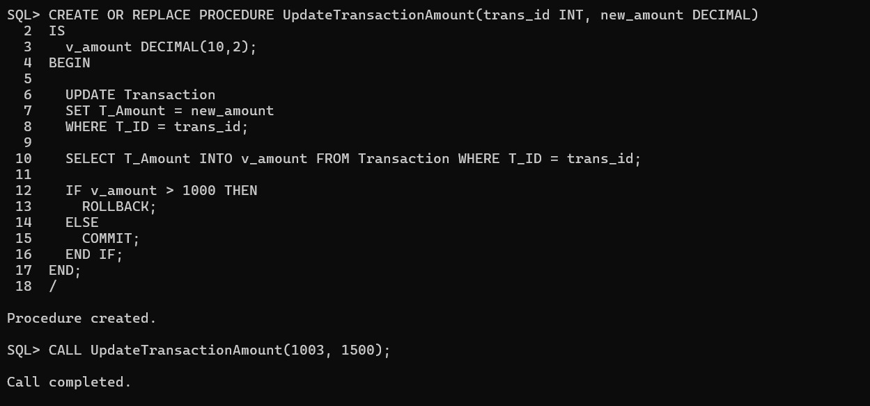

Slide 18
Result
Designing an expense tracker in a DBMS requires careful planning and consideration of user needs, data structure, and system functionality. By defining entities, attributes, and relationships accurately, we can develop a system that simplifies expense management, promotes data accuracy, and empowers users to make informed financial decisions based on insightful reports. This systematic approach ensures the effectiveness and usability of the expense tracker, benefiting individuals and businesses in managing their expenses efficiently.

